Slide 1
The Power of Guidance, Navigation & Control

Slide 2


Your Presenters
Eng. Abdulaziz Al-Shehri
B.S. Aerospace Engineering KFUPM – Patch 2016
4+ Years as GNC Engineer in SAMI AEC
Self taught pilot, trust me I can land it!
Eng. Faisal Al-Eyeoni
B.S. Aerospace Engineering KFUPM – Patch 2016
4+ Years as GNC Engineer in SAMI AEC
2+ Years as Performance Analyst in LIGNex1
I read books, I swear!

Slide 3
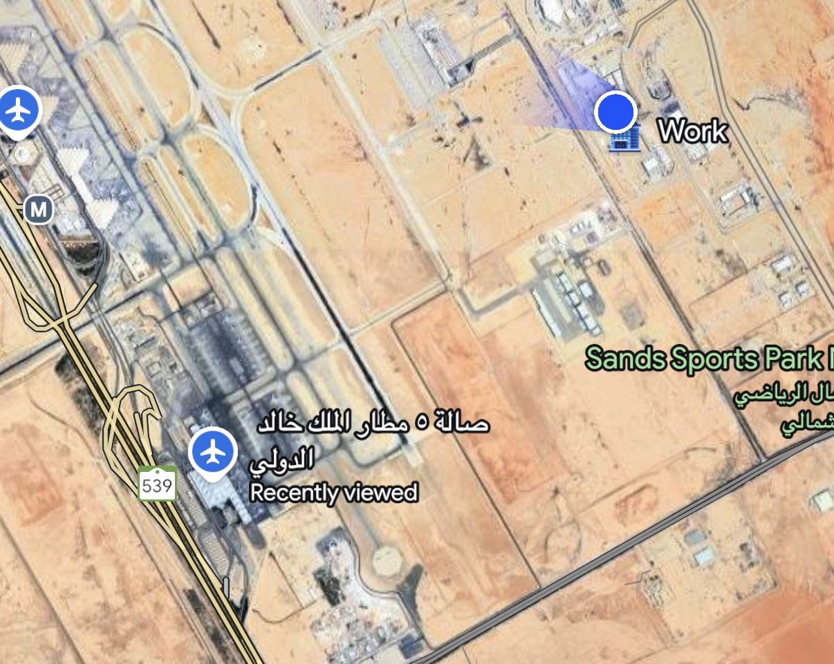
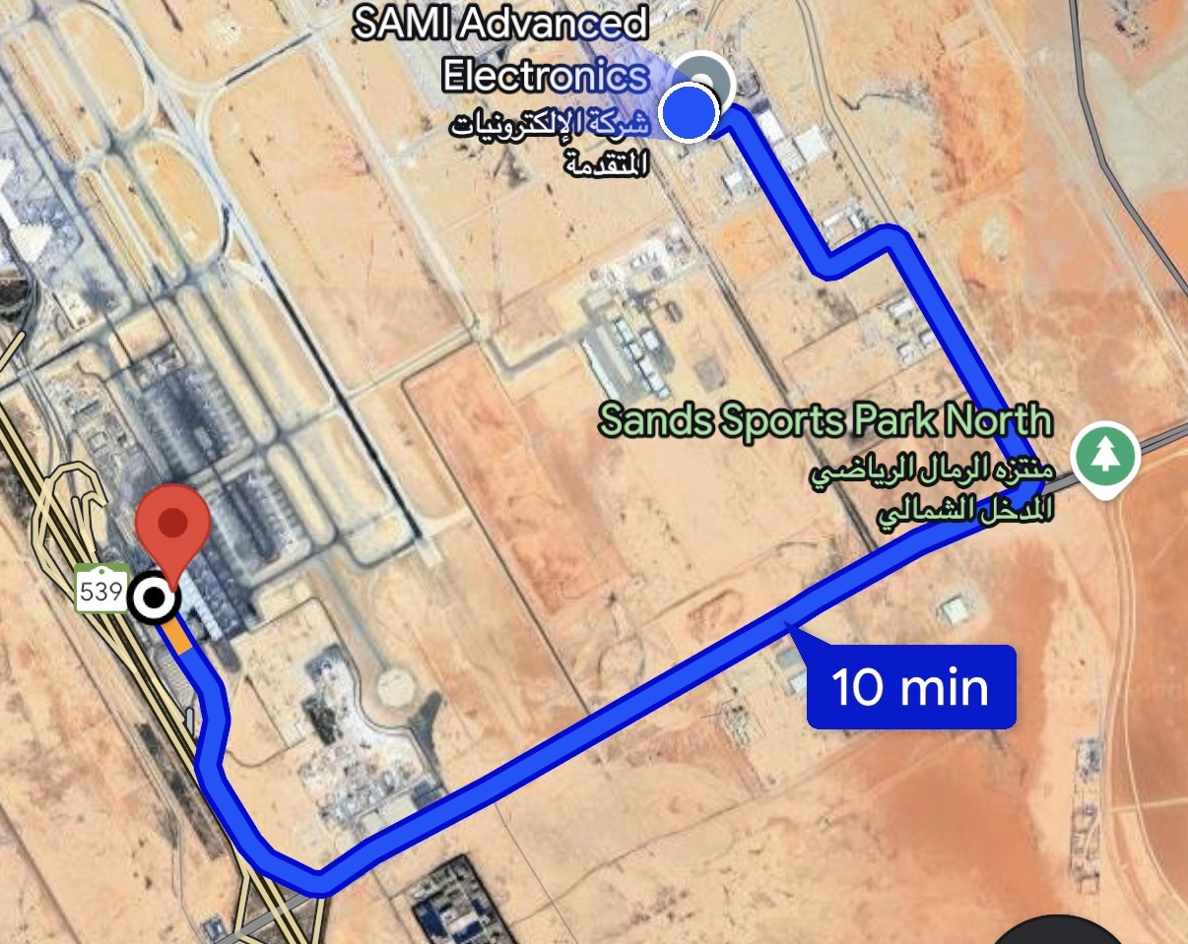

What is Guidance, Navigation and Control?
Navigation
Knowing where you are
Guidance
Choosing the best path
Control
Using the available controls to follow the path

Slide 4
GNC Role
GNC
Image Processing
Aerodynamics
Propulsion
Mechanical Design
Simulation and Modelling
Performance
Software
Testing
Seeker
The Guidance, Navigation and Control department are central to the system design process, we:
Interface with all other parts of the System
Are often called on to quantify the impact of issues elsewhere in the system.
Have a broad understanding of the system, as well as specialist knowledge of the GNC algorithms.
Are involved in system development from concept phase through to in service support.

Slide 5



Guidance and Control Algorithms
Algorithms
Guidance law
Steering law
Autopilot
Guidance law determines required missile trajectory
Steering law determines how this is achieved (interface between guidance and autopilot);
Autopilot produces necessary fin or thruster demands to manoeuvre the airframe such that it follows the demanded trajectory and remains in stable flight.
$\left[\begin{matrix}a_{X}^{B} \\ a_{Y}^{B} \\ a_{Z}^{B}\end{matrix}\right]$dem
$\left[\begin{matrix}φ \\ {\hat{a}}_{Z}^{B} \\ {\hat{a}}_{Y}^{B}\end{matrix}\right]$dem
$\left[\begin{matrix}ξ \\ η \\ ζ\end{matrix}\right]$dem
Actuators
Instruments
Airframe
Seeker/
estimator
Kinematics
Target Motion
Real World

Slide 6
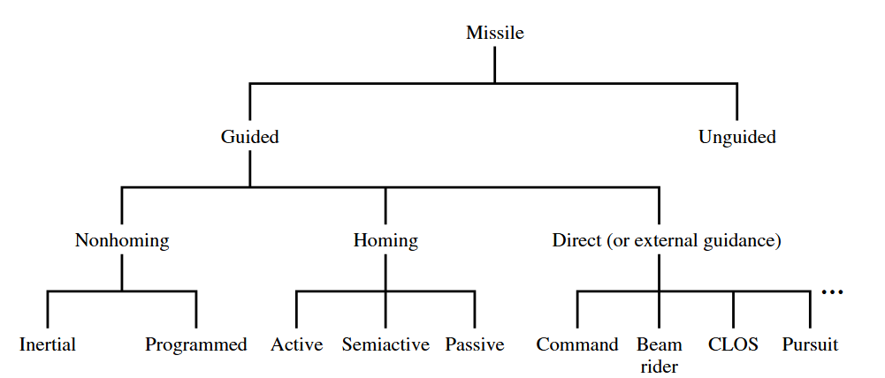
Missile Guidance Types
Non-Homing Guidance
Missile flies to target coordinates provided before launch.
Homing guidance
Target tracked by missile seeker
Used in terminal phase
Direct guidance
Target tracked independently (external) of the missile

Slide 7
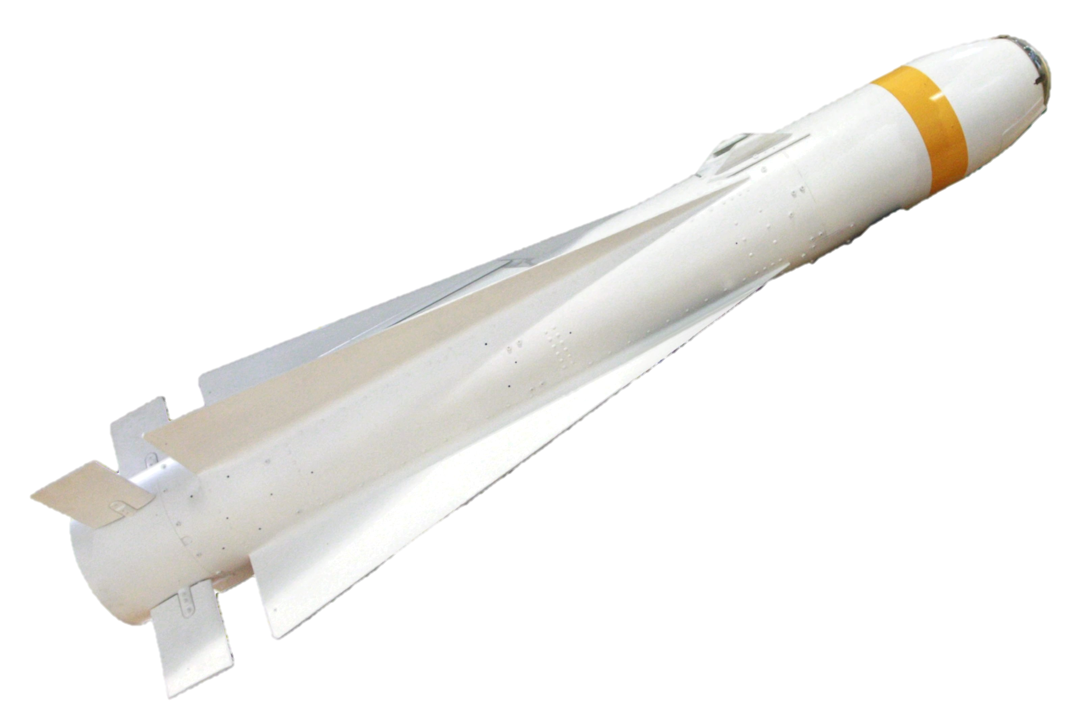

Non-homing Guidance
The missile autonomously determines its position and velocity during flight through inertial measurement units (navigation)
Interception maneuvers are executed based on the known missile-target relative geometry without direct target sensing (guidance)
$$V_{m}$$
Target

Slide 8
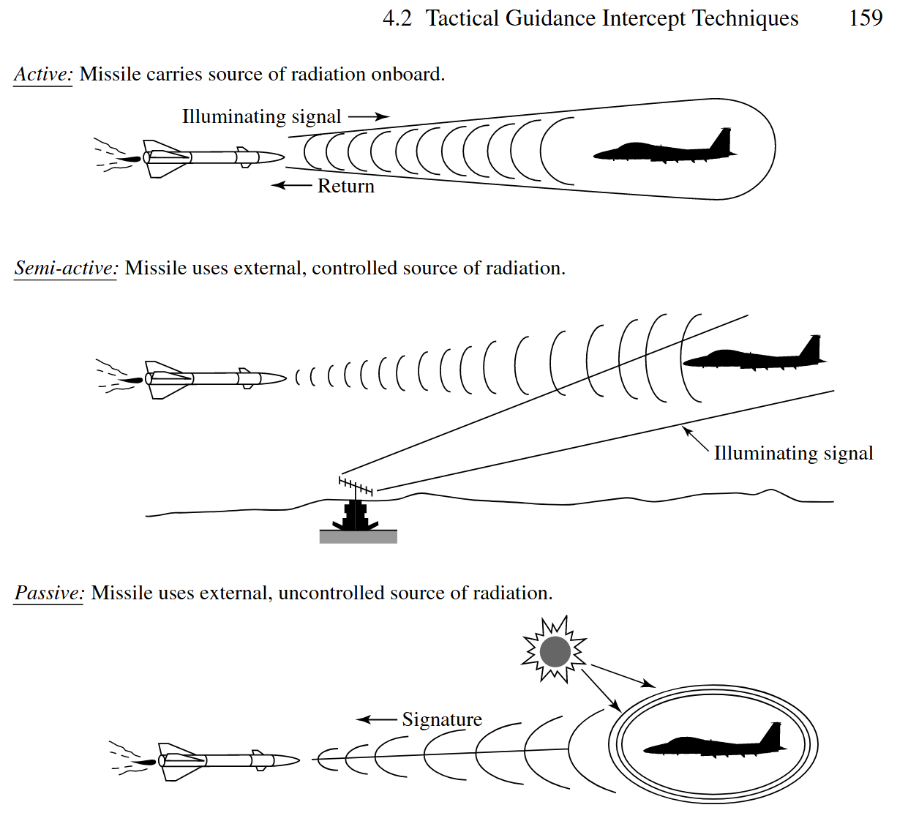
Homing Guidance
Homing guidance is used to describe a missile system that can sense the target by some means, and then guide itself to the target by sending commands to its own control surfaces
Homing systems may be classified in three general groups as follows:
Active
Semi-Active
Passive

Slide 9
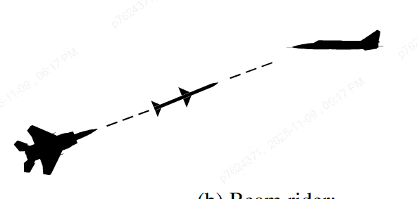
Direct guidance
The ground/aircraft system transmits a guidance beam toward the target
The missile detects its position relative to the beam centerline using onboard receivers
The missile autonomously corrects its flight path to remain within the beam until intercept
Beam rider

Slide 10
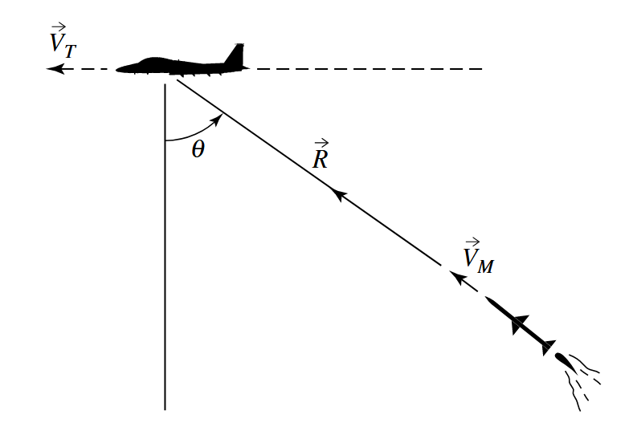
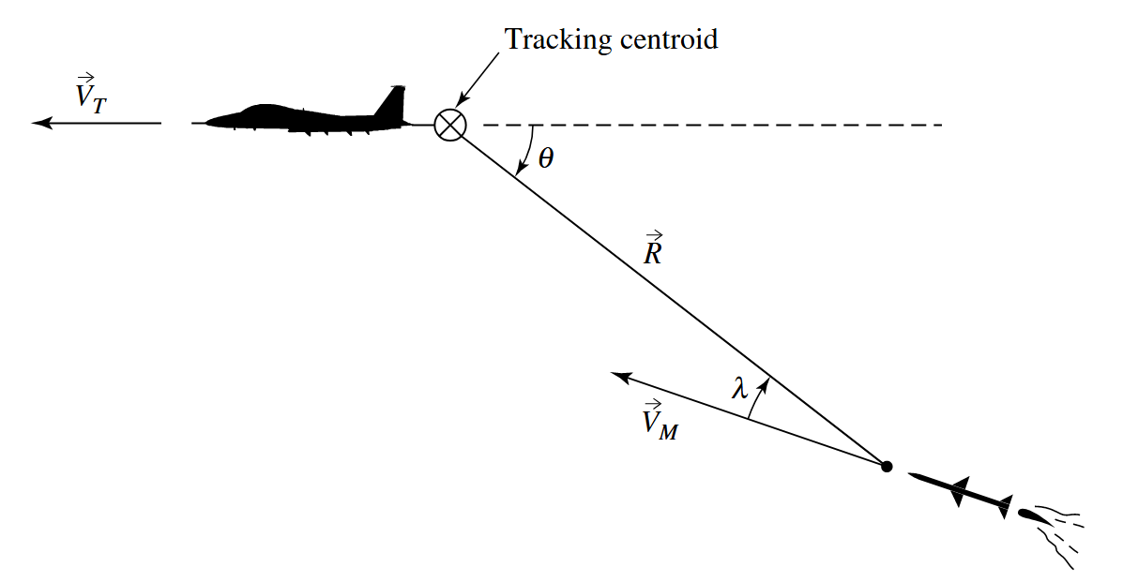
Development of Guidance Laws
The simplest guidance method is pursuit guidance – just point the missile directly at the target at all times.
This is easy to implement but often results in the missile chasing the target's tail, wasting energy and time.
There is no need to differentiate sightline rate, but will result in a tail chase in many engagements.
Most modern missiles use proportional navigation (PN) instead.
PN works by keeping the line-of-sight angle constant – if the angle to the target isn't changing, you're on a collision course.
Think of it like crossing a street: if a car's position relative to you stays constant, you'll collide unless someone changes course.

Slide 11
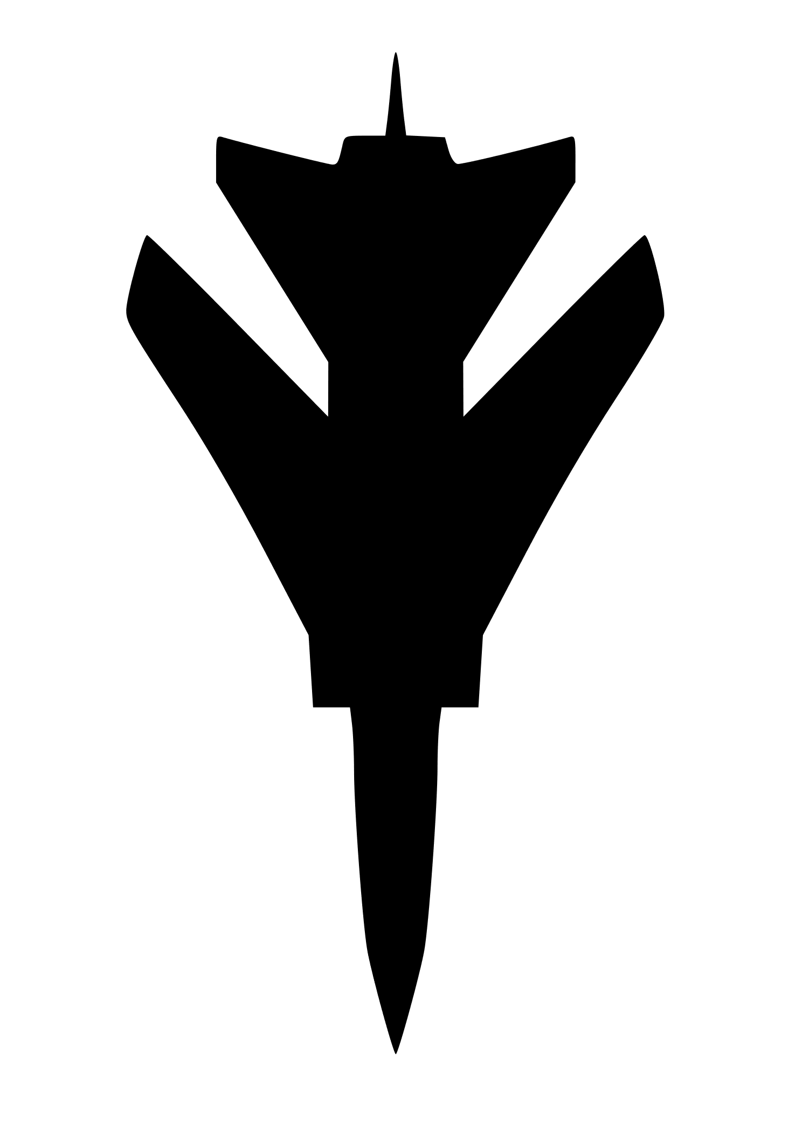
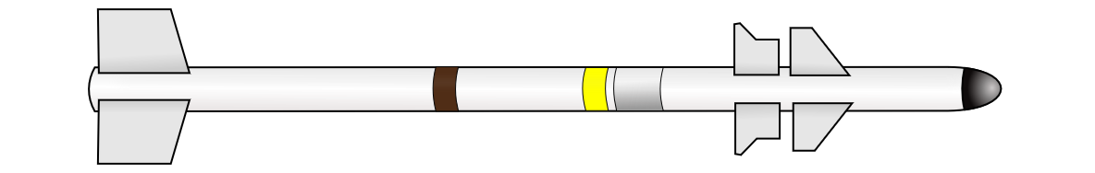
Guidance Comparison
Target
Pursuit
Proportional

Slide 12
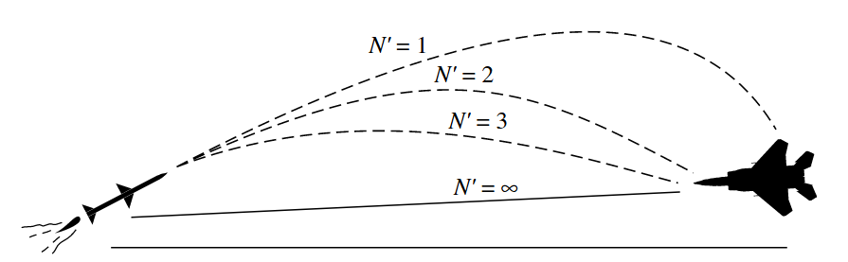
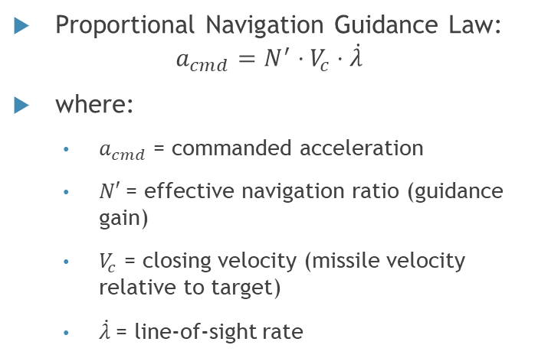
Effect of Navigation Ratio (N') on Missile Trajectories
N' is the proportional navigation gain - it determines how aggressively the missile responds to line-of-sight rate changes.
N' = 1-2: Shallow initial turn, aggressive maneuvering near target
N' = 3-5: Balanced trajectory - early correction with moderate maneuvers (typical for real missiles)
N' = ∞: Pure pursuit - missile always points directly at target
Proportional Navigation Guidance Law: $a_{cmd}=N^{′}⋅V_{c}⋅\dot{λ}$
where:
$a_{cmd}$ = commanded acceleration
$N′$= effective navigation ratio (guidance gain)
$V_{c}$ = closing velocity (missile velocity relative to target)
$\dot{λ}$= line-of-sight rate

Slide 13
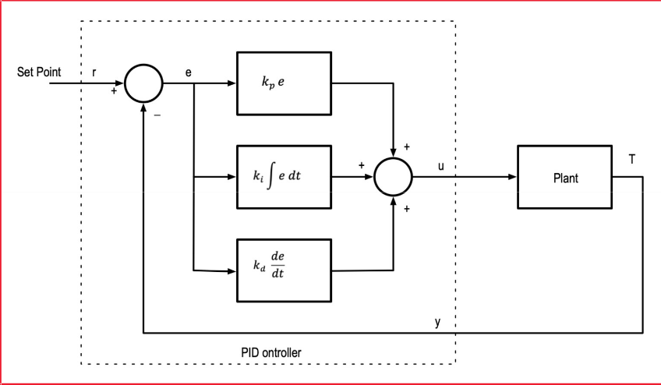
Control Terminology
Demand
The demand, also known as the setpoint (r), is the goal the controller needs to meet.
The error between the demand and the current value is ‘driven to zero’ by the control law.
The current value is also known as the process value (y).
Gains
Tunable scaling applied to the different paths in the control law.
PID control
A feedback control law with terms Proportional, Integral and Derivative of the error.

Slide 14
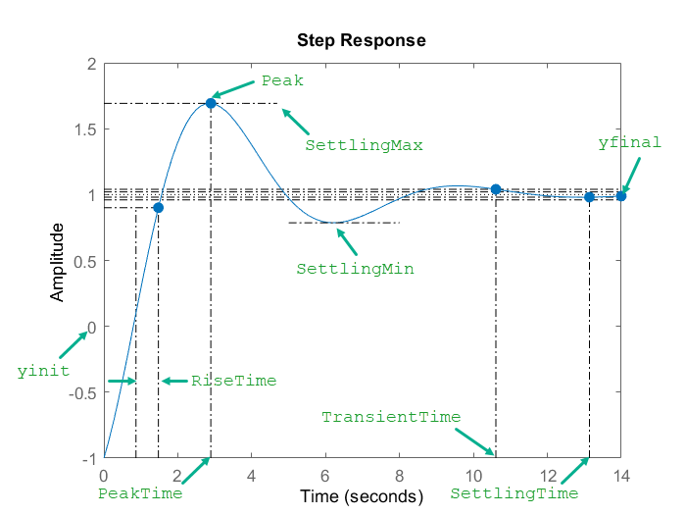
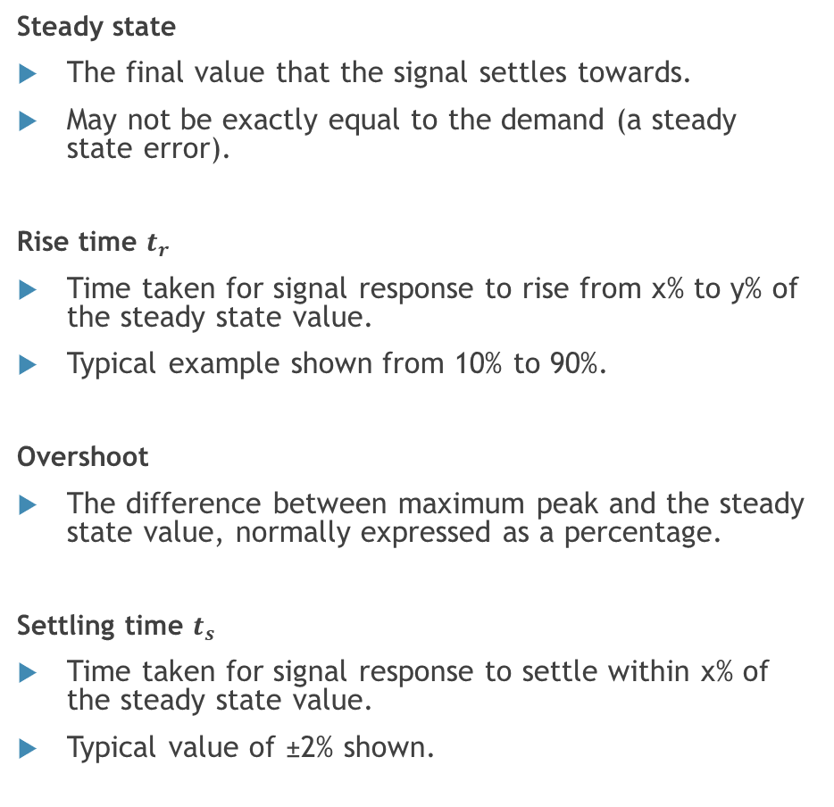
Control Terminology
Steady state
The final value that the signal settles towards.
May not be exactly equal to the demand (a steady state error).
Rise time $t_{r}$
Time taken for signal response to rise from x% to y% of the steady state value.
Typical example shown from 10% to 90%.
Overshoot
The difference between maximum peak and the steady state value, normally expressed as a percentage.
Settling time $t_{s}$
Time taken for signal response to settle within x% of the steady state value.
Typical value of ±2% shown.

Slide 15
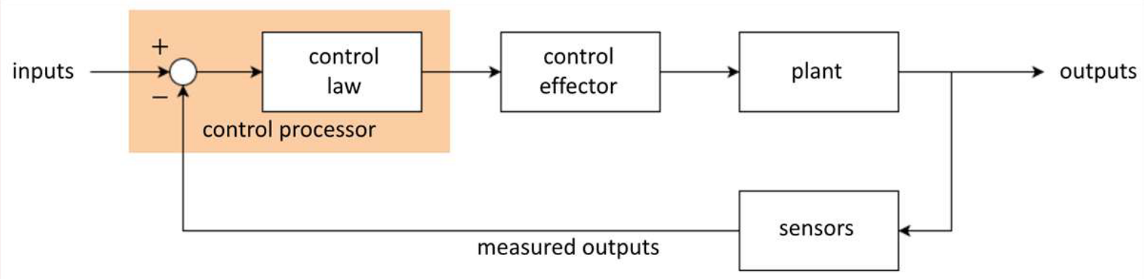
Top-level feedback control structure
In general, a feedback control system has the following top-level structure:
Main concerns of the closed-loop system are:
Stability (and robustness).
Accuracy of demand following/tracking.
Speed of response.

Slide 16
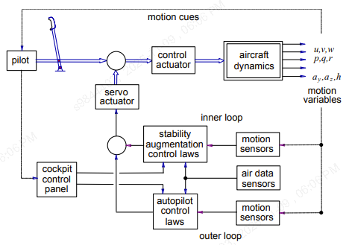
Flight Control Systems (FCS):
Stability augmentation systems (SAS) “Assists the Pilot”
Improves basic airframe stability
Simple to implement
High functional visibility
Design requires good knowledge of airframe dynamics
Improves flying qualities and safety
Does not always improve handling qualities
Command and stability augmentation systems (CSAS)
Same features and functions as stability augmentation
Command augmentation for handling qualities tailoring
Improves flying qualities, handling qualities and system safety
Autopilot “Replaces the Pilot”
Provides automatic flight path control in lieu of pilot
Design constraints differ markedly from those for command and stability augmentation
Controller function can usually be specified mathematically
Design and implementation may be complex
Requires a good knowledge of control and systems theory0

Slide 17
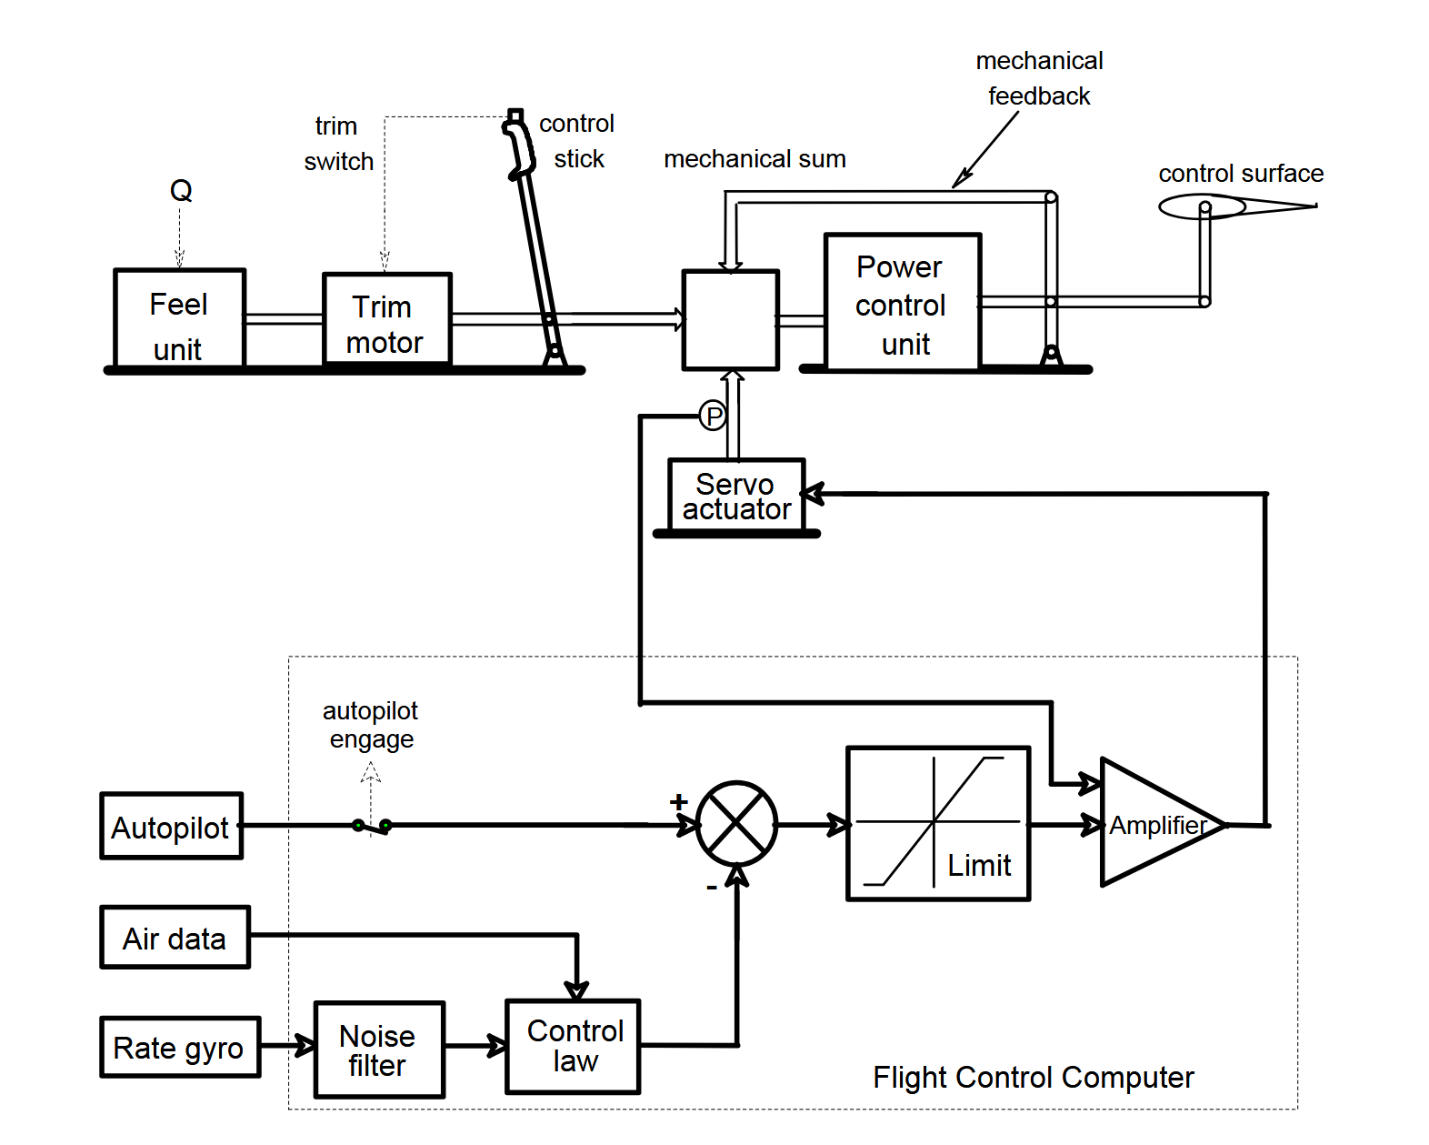
Flight Control Systems (FCS):
Stability augmentation systems (SAS):
Stability augmentation systems

Slide 18
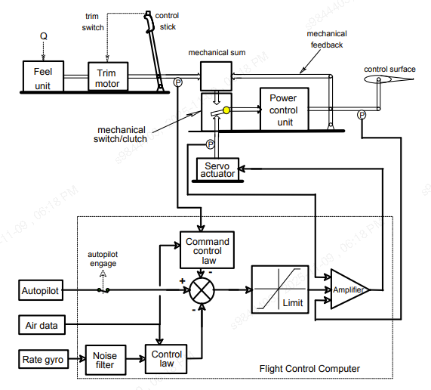
Flight Control Systems (FCS):
Command and stability augmentation systems (CSAS)
Command
Stability augmentation systems

Slide 19
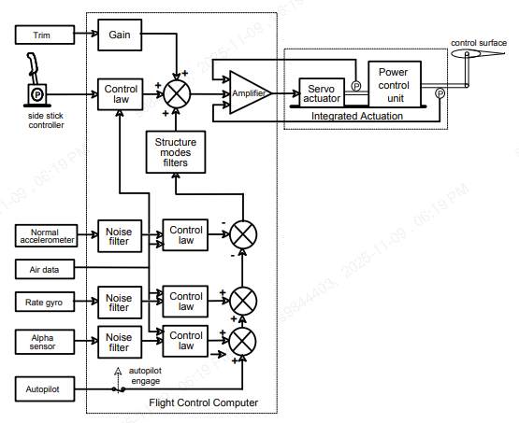
Flight Control Systems (FCS):
Flight-By-Wire System (FBWS)
Flight-By-Wire System (FBWS)

Slide 20
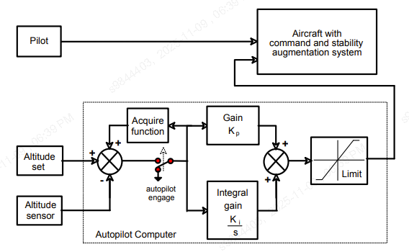
Flight Control Systems (FCS):
Autopilot
Autopilot

Slide 21
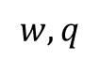

Control Design (Open-Loop)
$$δ$$
Plant
“Short Period Mode”
$$w, q$$
Low damping
High frequency oscillations
No tracking performance

Slide 22


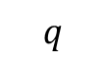
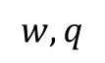
Control Design (Pitch SAS)
Unstable/Marginally Stable
Low damping
High frequency oscillations
Gain
“$K_{q}$”
$$δ$$
Plant
“Short Period Mode”
$$w,q$$
$$q$$
Highly stable “High margins”
Well damping (𝜁=0.7)
Non-oscillatory

Slide 23

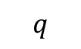
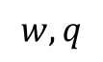




Control Design (Vertical Speed Autopilot)
No Tracking Performance
Constant pilot corrections
$$w_{cmd}$$
+
$$ε$$
Controller
$$δ$$
Plant
“Short Period Mode”
$$w,q$$
+
-
-
$$w$$
Gain
“$K_{q}$”
Can track a specific speed
No need for pilot corrections
$$q$$

Slide 24
Earth Navigation: History
Known Positions
Navigation is the science of defining the current position, velocity and attitude of the vehicle. Historically this has concentrated on position only using a combination of:
Position Fixing
Land fixing by compass bearing. Sea fixing by observations of the sun (e.g. use of Sextant, marine ‘watch’ – John Harrison).
Dead-reckoning
Navigation between fixes using measures of direction and speed:
Compass
Measurement of speed (‘knots’)
Measurement relative to reference - use of sea speed tables.
Guess
True

Slide 25
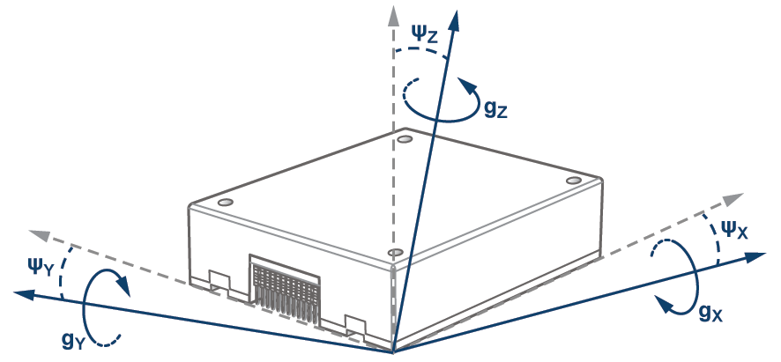
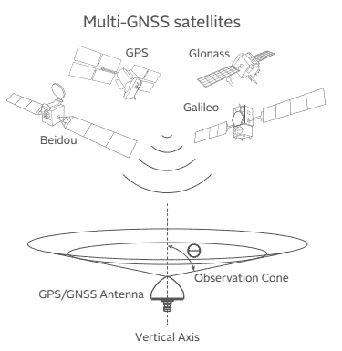
Modern Navigation Systems
Requirements
Ideal system requirements:
Low cost
High accuracy and reliability
Small size and weight
Low power consumption
Modular
Ease of operation
Robust to threats
Outputs of:
Position
Velocity
Attitude
Accuracy estimates
Timing
Components
‘Dead-reckoning’ systems:
Inertial Navigation System (INS)
Relative Navigation (aids to DR):
Doppler radar
Terrain aiding (TERPROM)
Image Based Navigation (IBN)
Collaborative Navigation
Timing and Synchronization
Absolute Navigation (position fixes):
Radio Navigation (TACAN/VOR/DME)
Signals of opportunity (planned and opportunistic)
Satellite systems (GNSS/GLONASS, Galileo, Beidou)
IBN and Imaging systems, IR & EO (SMAC)
Terrain aiding (TERPROM)

Slide 26
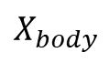

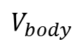

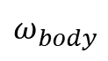
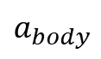

Inertial Navigation
Uses measurements of acceleration to calculate change in velocity and position by successive integration
INS contains 3 ACCELEROMETERS each of which measures acceleration in a single direction
accelerometers notionally mounted such that these directions are perpendicular to each other (i.e. they form a ‘triad’) – usually mounted away from center of rotation and need to be transformed
In order to navigate with respect to an inertial frame of reference we need to keep track of the directions in which the accelerometers are pointing
INS therefore (normally) contains 3 GYROS each of which effectively measures the rotational movement about a single accelerometer axis
$$ω_{body}$$
Euler Angles
Gravity Compensation
$$ʃ$$
Position
Velocity
Attitude
$$X_{body}$$
$$V_{body}$$
Transform into Navigation Axes
$$a_{body}$$
$$ʃ$$
$$ʃ$$

Slide 27
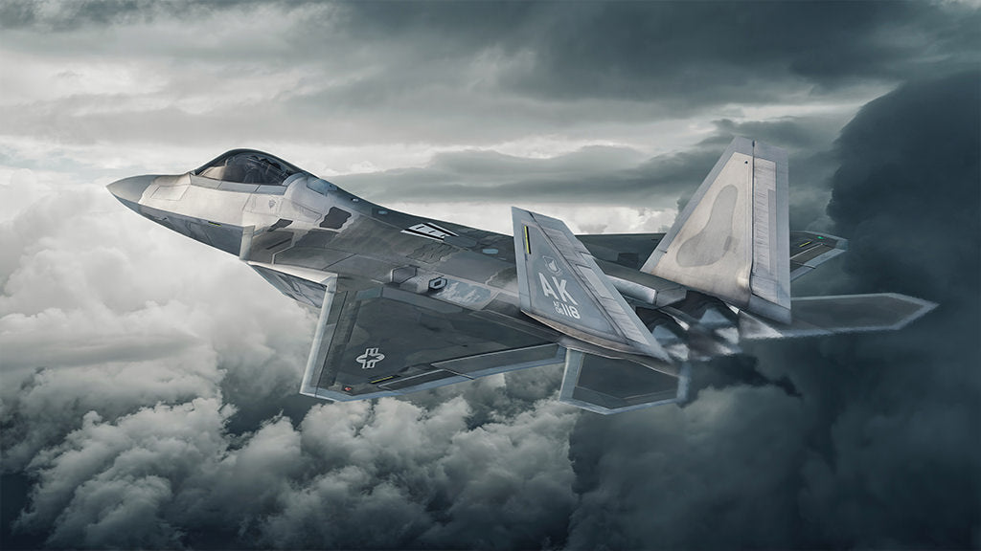
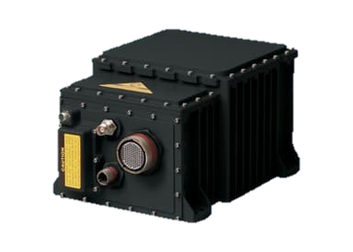
IMU and INS
IMU (Inertial Measurement Unit)
Terms used to describe the group of inertial sensors
Accelerometers and gyros + conditioning electronics where required
Provides outputs of
Angular rate (or angular incremental)
Linear accelerations (or velocity incremental)
INS (Inertial Navigation System)
Comprises an IMU and a computer
Computer implements a set of navigation equations
Provides outputs of
Attitude (Euler, Quaternions, DCM)
Velocity (normally relative to LGA)
Position (latitude/longitude)
Height (normally AMSL)
Northrop Grumman Advances
LN-251 Inertial Navigation System

Slide 28
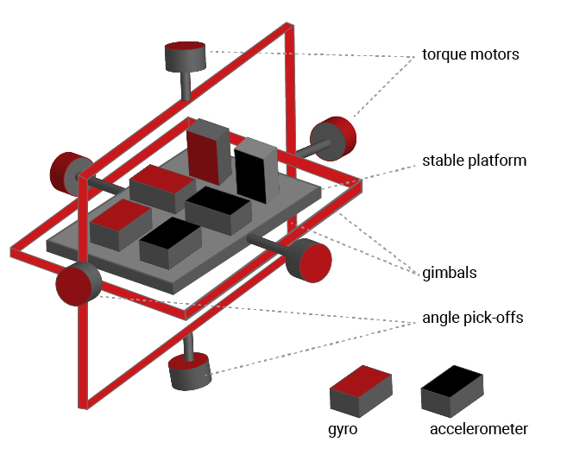
Types of Inertial System
Platform Systems
Inertial platform uses gyros to maintain accelerometers in fixed attitude (i.e. gyro measurements are not used within the navigation equations).
For navigation in Local Geographic Axis (LGA) the computer needs to keep the platform horizontal by sending torque commands to servo motors.
Minimum set of 3 gimbals required.
Strapdown Systems
Fixed to vehicle body.
Gyro measurements used in navigation computations.
Gimbals replaced by high-speed computer to measure attitude.

Slide 29
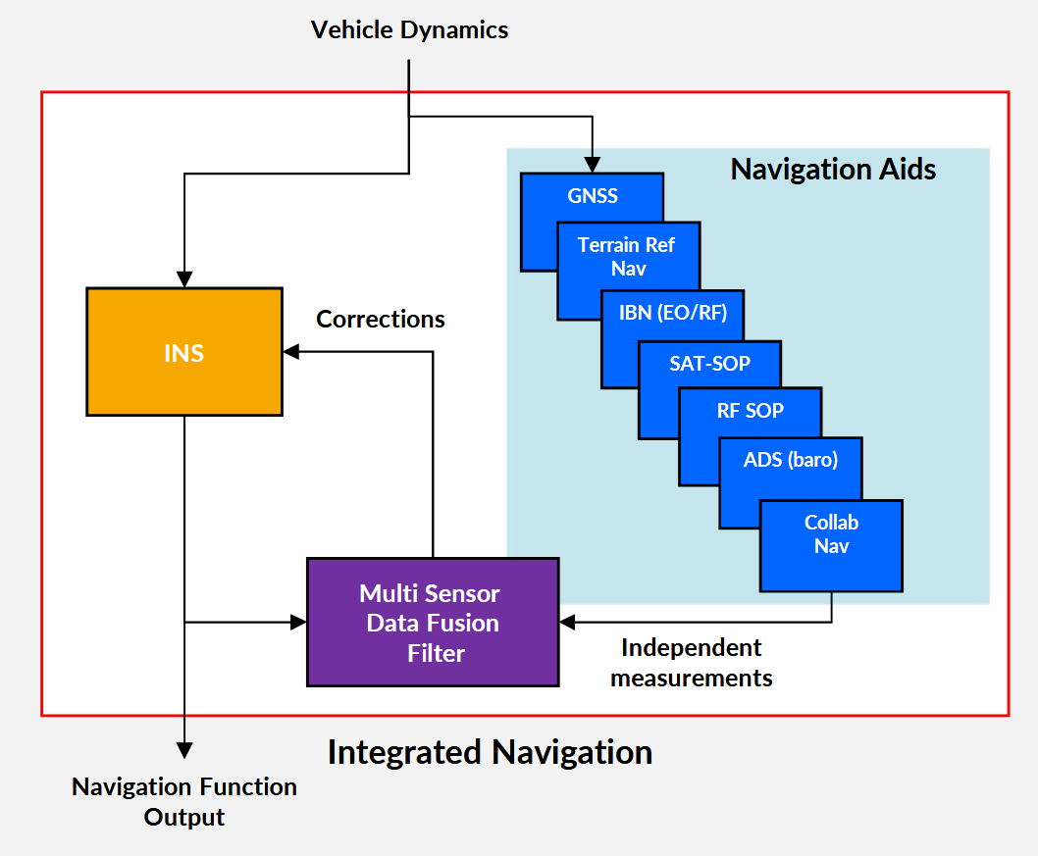
Integrated Navigation
Imperfect Measurement
Extra Sensor Data
Feedback Corrections

Slide 30
Filtering & Fusion
Fusion algorithms must be capable of combining the data from all alternative sources of navigation data.
Often these will have complementary strengths.
Usually, the approach is based on Kalman Filters.
Predict Current System States using a Model of the System
Inaccurate Model
Best Estimate of System State “Best of Both Worlds”
Combine Predictions and Measurements using a Fusion Algorithm
Starting Estimate System States
Measure System States using Sensors
Noisy Data

Slide 31
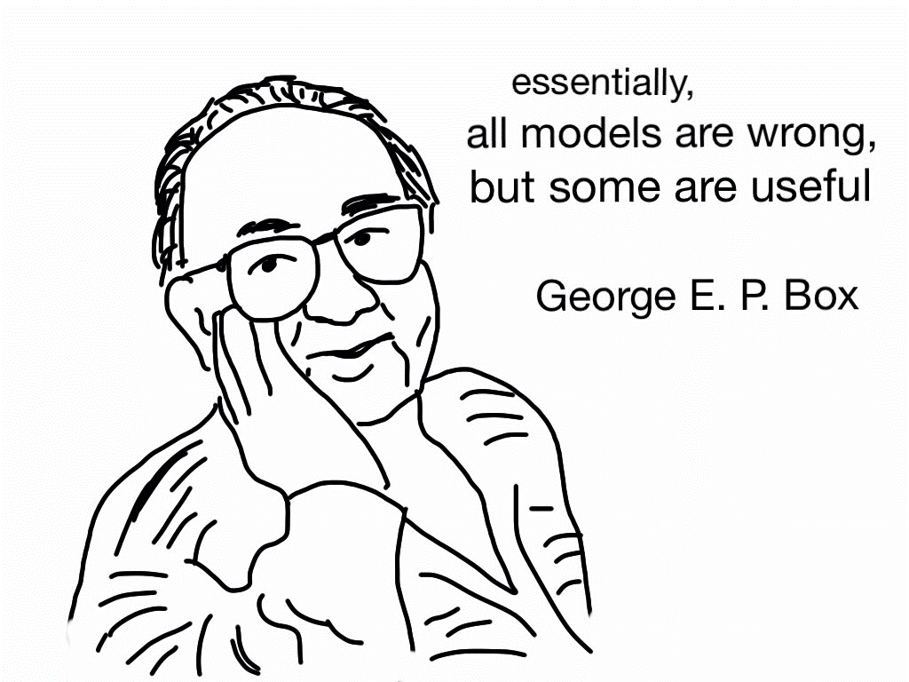
What is Modelling and Simulation?
Modelling: Refers to the process of representing the dynamic behavior and/or structure of a system.
Simulation: Refers to the use of a system model to investigate the performance of that system and/or evaluate effects of changes to the system, both physically and/or algorithmically.

Slide 32
Model Top View
Guidance and Control
Guidance law
Steering law
Autopilot
Navigation / Sensors
Airframe
Environment
Actuators
Earth
Seeker/
estimator
Instruments / Sensors
Aerodynamics
Wind
Equations of Motion
Propulsion
Atmosphere

Slide 33
Earth Models
No Curvature (Flat Earth)
Constant gravity, Cartesian coordinates. Fast and simple but accumulates error with range.
Constant Curvature (Spherical Earth)
Accounts for curvature and altitude-dependent gravity.
Non-constant Curvature (Oblate Spherical Earth)
Models Earth's true ellipsoidal shape (WGS-84). Essential for GPS integration.

Slide 34

Gravity Models
Constant Gravity
Altitude-Varying Gravity
Position-Varying Gravity

Slide 35

Atmosphere Models
The base standard for atmospheric modelling has, for a long time, been the International Standard Atmosphere (ISA).
It relates the variation in pressure, temperature, density and viscosity of the Earth’s atmosphere against height above mean sea level for a hypothetical “standard day”.

Slide 36

Kinematics / Rigid-Body Dynamics Models
Model fidelity is determined by the degree-of-freedom (DOF) model selected, balancing accuracy against computational complexity.
Rotation
Translation
Type | Roll | Pitch | Yaw | X | Y | Z
3 DOF | ❌ | ✔️ | ❌ | ✔️ | ❌ | ✔️
5 DOF | ❌ | ✔️ | ✔️ | ✔️ | ✔️ | ✔️
6 DOF | ✔️ | ✔️ | ✔️ | ✔️ | ✔️ | ✔️

Slide 37
References
Guidance:
Siouris, G. (2004). Missile Guidance and Control Systems. Imprint: Springer.
Navigation:
Titterton, D., & Weston, J. (2009). Strapdown Inertial Navigation Technology. The Inst. of Engineering and Technology.
Control:
Cook, M. (2007). Flight Dynamics Principles: A Linear Systems Approach to Aircraft Stability and Control. Butterworth-Heinemann/Elsevier.
Fielding, C. (2010). Fly‐by‐Wire Flight Control Systems.
Simulation and modeling:
Zipfel, P., & Schiehlen, W. (2001). Modeling and Simulation of Aerospace Vehicle Dynamics.
Stevens, B. (2010). Aircraft Control and Simulation

Slide 38

Thank you for listening
Questions?
SURVEY
To Access Content

